Slide 1
Numeric Data Types
Session Two
Notes:
Welcome to our second session! Today we are going to start coding in Python and talking about the threat intelligence field within cybersecurity! To start off our Python learning we will be covering a handful of topics - the most important of which is the notion of data types. In particular, we’re going to start with different types of numeric data, since they are some of the simplest and most conventional to explain for beginners because it is just doing math with code.

Slide 2
Reminders
Due Today
Due Next Week
Homework from Session One
Practice quiz on Session One Content
Homework from this session
Quiz on this session’s content
Notes:
As some quick reminders before we get into things, today we’re going to have your first practice quiz and your practice homework is due.

Slide 3
Reminders
Due Today
Due Next Week
Homework from Session One
Quiz on Session One Content
Homework from this session
Notes:
Next week you’ll have your first graded homework assignment due. So please be prepared and feel free to come to office hours for assistance on the homework or for additional practice on the material we went over in class.

Slide 4
Agenda / Topics
1. Start of Class & Quiz
2. Data Types
3. Casting & Conversion
4. Break
5. Security Topic: APTs & IOCs
6. Overflow / Q&A / Dismissal
6:30 - 7:00
7:00 - 7:45
7:45 - 8:00
8:00 - 8:15
8:15 - 8:45
8:45 - 9:00
Notes:
Today we’ll have a q&a to answer any questions from last week and then we’ll be doing the practice quiz. After that, we’ll start the lecture. We’ll cover a handful of topics with a break at 8 pm and we’ll wrap the class up around 9 pm.

Slide 5
Q&A
?
Notes:
Any questions about the class structure or how to use Deepnote?

Slide 6

Quiz
Access the quiz here: https://forms.gle/24t1QvPV8TwGLZVG8
(Link in chat)
Screenshot before submitting & don’t refresh.
Notes:
Alright! We will send you the link to the quiz in the Zoom chat.
https://forms.gle/24t1QvPV8TwGLZVG8
Two important reminders. When we hit the time limit we will announce that the quiz is over. We will then give you a few seconds to screenshot your work and then we will close the Google Form which means no additional answers will be accepted. Please please get your answers submitted prior to us closing the form.
The reason we ask you to screenshot or otherwise record your answers before you hit submit is because Google forms will drop your answers if your connection drops. Similarly, do not refresh the quiz during the quiz because that will delete your answers. The connection drops infrequently but the few times it happened last semester were a real pain for everyone involved.

Slide 7
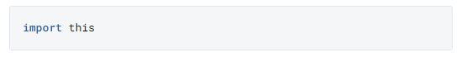
The Zen of Python
Go to Deepnote and in a code cell type the following and then run the cell:
Notes:
Everyone please open Deepnote.
In a code cell type “import” space “this” and then run the cell.
Reminder that to run a cell you hit shift and enter.

Slide 8
Zen of Python
Beautiful is better than ugly.
Explicit is better than implicit.
Simple is better than complex.
Complex is better than complicated.
Flat is better than nested.
Sparse is better than dense.
Readability counts.
Special cases aren't special enough to break the rules.
Although practicality beats purity.
Errors should never pass silently.
Unless explicitly silenced.
In the face of ambiguity, refuse the temptation to guess.
There should be one-- and preferably only one --obvious way to do it.
Although that way may not be obvious at first unless you're Dutch.
Now is better than never.
Although never is often better than *right* now.
If the implementation is hard to explain, it's a bad idea.
If the implementation is easy to explain, it may be a good idea.
Namespaces are one honking great idea -- let's do more of those!
Statements & Best Practices
Notes:
Best practice is to try write code that follows what we call the Zen of Python - 20 Aphorisms that describe the nature of the language and how to approach coding in it. I’ve highlighted a handful here that are pertinent to you as absolutely beginners.
The underlying principle that backs almost all of these aphorisms is that, at its heart, Python is intended to be reusable and accessible. Guido talked about creating Python in a 1996 essay and he outlined a lot of his inspiration and reasons for developing Python as he did. I’ll read a short excerpt on what he wrote were guiding principles. He said:
“This emphasis on readability is no accident. As an object-oriented language, Python aims to encourage the creation of reusable code. Even if we all wrote perfect documentation all of the time, code can hardly be considered reusable if it's not readable. Many of Python's features, in addition to its use of indentation, conspire to make Python code highly readable.”
Python was designed with shareability and code re-use in mind. Keeping your code direct, simple, and clear in its intent and implementation creates code “lego bricks” that others can easily plug in an use for their own purposes.
One simple and encouraging one to start with though is the first line, “Beautiful is better than ugly.” Python is known for its readability and simplicity. Python explicitly seeks to create code that is appealing and elegant for others to interact with.
The line “simple is better than complex” is another core principle which lends itself to the teachability of this language. It means that it is better to make code simple when possible. The concern, and critique of other languages, is that hiding or complicating code functionality makes it harder for others to understand the code you have written and that as others try to re-use your code they may induce unexpected issues or bugs.
As you grow as a Python programmer, it’s important to return to these fundamentals. Becoming a good Python programmer - rather than just a good programmer - involves understanding these principles, how they are reflected in the language, and how to implement them yourself in code.

Slide 9
Zen of Python
# statement one
# statement two; statement three
# statement \
# four
# statement five (that depends on four)
Statements & Best Practices
Notes:
As a general rule, each line of Python code (in any kind of program, but for us a line in a code cell in a notebook) represents a new statement. What’s a statement?
In typical English, a statement is defined as “a definite or clear expression of something in speech or writing”; in code, this definition is maintained. A “statement” is a clear expression of intent in code. You can think of these as Python’s sentences from which larger functions and programs are composed.
Determining how much action or intent to put in a given statement (or a given line) is something you’ll get the hang of as you go. As in English, there are lots of grammatical rules - but it’s possible to write the Python equivalents of run on sentences or to code like you’re Ernest Hemingway in short bursts. Python is expressive and allows for a bit of freedom in how you construct and set forth your ideas, and oftentimes two programmers set to the same conceptual task will create very different solutions (this is why detecting plagiarism in code is quite possible).

Slide 10
Whitespace
# statement one
# statement two; statement three
# statement \
# four
# statement five (that four depends on)
Whitespace (tabs, new lines, spaces) are important to how Python operates. Common conventions to know:
Tab: \t
New line: \n or \r
Each line is a new statement.
Some statements go together in a meaningful way and they will be indented (we’ll learn these)
Semicolons allow multiple statements per line (uncommon)
Backslash allows a statement to continue on another line
Python Statements
Notes:
Outside of best practices, there are some enforceable rules and, of course, ways to bend them.
These are much like punctuation and other components of English.
For example, in English you can put together two sentences - two concrete thoughts with both a subject and object - together in one sentence with a semicolon; this text device exists to connect two independent but interrelated thoughts. The same is true in Python and you can use a semicolon to put two statements on the same line. This is pretty uncommon - as it is in English - but some people will use them more than others stylistically.
In English we have no rules about how many lines a sentence can go for (we just call some of these longer entries “run-on” sentences and they are more or less frowned upon. In Python the equivalent is extending a line of code over multiple lines using backslashes. Like run-ons, these are frowned upon but sometimes they are the best or only way to write a bit of code.
In addition to each statement taking on a new line, Python also uses tabs (or spaces) in a meaningful way. Some statements in Python will follow one another in a dependent way - some code only runs if specific conditions are true or can only be run once another piece of code has been started. In these cases there are special rules for indentation. The dependent statements will be indented beneath the lines they depend on.
We’ll talk more about this later - but the important thing is to recognize that how you space and indent things in this language is important, so don’t randomly insert whitespace.

Slide 11
Questions so far (zen of python, whitespace)

Slide 12
Storing Data in Python
Objects and Types
Notes:
Storing data is a core component of how any language in computer science functions. In order to run computations, make decisions, or manipulate data, you have to have some means of storing and organizing it that is consistent from user to user and from machine to machine.
Different programming languages have different approaches and this results in different behaviors and interesting quirks.

Slide 13
Objects
‘First Class” Objects
Objects define what something is, what properties it has, and what can be done with it
Objects create clear rules and definition for programmers
All objects have a type and all objects of the same type have common properties and functionalities
Notes:
Python stores data in “first class” objects. This is an extremely core design consideration in the language; all core information that you might work with in Python - like text, numbers, and so on - are represented in python through the abstract concept of an object.
Objects are Python’s way of defining what type of thing something is, what properties that thing has and what can be done with it. Objects create clear rules and definition for code in order to help programmers know how to interact with and use it!
In Python, every object has a type, and all objects of that type have certain common properties and certain common functionalities. Today we are going to talk about two fundamental data types that exist in Python to represent numbers. We’ll start here for this week and then in subsequent weeks we will continue to expand upon this concept as you learn more about what data types exist and how to interact with them.
Make sure you have your interpreter (deepnote) open. As we go through each slide, I encourage you to test each concept in your browser.

Slide 14
Pythonic Data Types
Boolean
Integer
Floating point
Complex
Text string
List
Tuple
Bytes
Bytearray
Set
Frozen set
dictionary
bool
int
float
complex
str
list
tuple
bytes
bytearray
set
frozenset
dict
Notes:
There are 12 basic data types in Python. During this class we will be teaching you 8 of the 12 basic data types.
The ones we won’t learn include complex numbers, means of representing bytes of data, and one structure for a frozen set (an immutable, or unchangeable, version of a set from mathematics). Byte and bytearray objects are used in the security space, but just for lower-level functionality than we are likely to need for this class. The others just aren’t something you’ll see very often in our space.
The objects we will cover are mostly those that are either used for basic math (integers, floating point numbers), those used for logical operations and decision making (booleans, which are true or false values), various structures for holding different kinds of data (tuples, sets, lists, and dictionaries are all different organizational structures); or they are designed for holding text (strings). We’ll go over these slowly over the course of several weeks learning one or a few at a time as needed.

Slide 15
Numeric Data Types
Floating point
Integer
Integers (“int”)
Floating Point Numbers (“float”)
int
float
Notes:
Today, we’re going to briefly introduce just two types of data - both different types that represent numbers.
The first type we will talk about is an integer, commonly called an “int”. And the second is a floating point number, or a “float”.
We’re going to start with these because mathematical operations in Python are pretty straightforward and intuitive if you’ve done any basic math before. This will let us get started without introducing any of the more complex topics right off the bat. I know for some of you math may not be that exciting or seem very security related, but this is the softest way for us to get started in Python by using knowledge you already have.

Slide 16
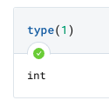
Checking Type
Go TO the interpreter and type:
Notes:
Type allows you to print out the type of any object you pass into it. This is a type of code called a function that we’ll learn about in more detail later. For now, just know that if you put “type” in your interpreter and then parentheses after it with an object inside them, your interpreter will tell you what the type of the object is.

Slide 17
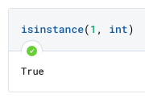
Checking Type
Go to the interpreter and type:
Notes:
You can also check if an item is of a specific type using the function isinstance. This will check if an object (the first item in the parenthesis) is of a specific type (the second item in the parentheses, separated by a comma). You will need to use the python reserved keyword for each type (see the table where we introduced each type; for integers, this is int and for floats it is float.

Slide 18
Integers
Type | Examples & Syntax | Properties / Description
Name: Integer Code to convert: int(x) | -1 0 1 Syntax: x = 1 | Integer whole numbers that you can use in mathematical operations

Slide 19
Floats
Type | Examples & Syntax | Properties / Description
Name: Floating Point Code to convert: float(x) | -1.1 -1.0 0.0 1.0 Syntax: x = -1.1 | Decimal-point precision real numbers that you can use in mathematical operations
Important: even though 1 and 1.0 have the same mathematical value, choosing to represent the value to decimal-point precision will cause it to be represented in Python as a floating point number. This may have the same mathematical value but it is a fundamental different data type with different properties and functionality.

Slide 20
Numeric Types: Integers & Floats
Type | Examples & Syntax | Properties / Description
Name: Integer Code to convert: int(x) | -1 0 1 Syntax: x = 1 | Integer whole numbers that you can use in mathematical operations
Name: Floating Point Code to convert: float(x) | -1.0 0.0 1.0 Syntax: x = -1.1 | Decimal-point precision real numbers that you can use in mathematical operations
Notes:
Integers
In Python, an integer is a “whole number”, a numeric value with no decimal precision. Integers can be positive, negative, or zero but they must be whole.
To declare an integer, you merely need to set that integer equal to any whole number. There is no other syntax that identifies an integer - just the whole number.
Floats
Floats, or floating point numbers, are numbers with decimal precision. They may be positive, negative, or zero - so long as the decimal point is specified.

Slide 21
Quick Quiz
What is the type of each of the following?
1.0
1
-1.1
10
Float
Int
Float
int

Slide 22
Operators
Notes:
Guido van Rossum is the creator of Python. In his introduction to the language as well as in the Zen of Python they talk about how punctuation works in Python and how it intersects with functionality and readability.
“Yet another contribution to Python's readability is the choice to use punctuation mostly in a conservative, conventional manner. Most operator symbols are familiar to anyone with even a vague recollection of high school math, and no new meanings have to be learned for comic strip curse characters like @&$!.”
In Python, there are many different operators. We’re not going to talk about them all today - but we are going to talk about those commonly used in math. Let’s get into it!

Slide 23
Mathematical Operations
Operator | Description
+ | Addition
- | Subtraction
* | Multiplication
/ | Division
% | Modulo aka Mod
// | Floor division
** | Exponents
== | Equality
1+1
1.0+1.0
100/10
101//10
100%9
10**2
10*2
10==10
10==10.0
2==3.0
Notes:
This table shows some of the available mathematical operators that work on numeric data types in Python. These should all be fairly familiar to you from mathematics. The more unique ones that you may not be familiar with include modulo (“mod”), which gets the remainder that’s left over from a division operations (e.g. 3%2 is 1), floor division (which rounds down), exponentiation (which is NOT written with a carrot key; the item on the left is taken to the power of the item to the right, e.g. 5**2 is 5^2) and equality, which checks if two items are equal to one another.
Let’s do a couple of mathematical operations as a test. Feel free to calculate these yourself, but I also recommend testing at least some of them in your interpreter (notebook) so that you can get used to seeing output.

Slide 24
Comparison Operations
Operator | Comparison Being Made
== | Are these two things equal to each other?
!= | Is this thing not equal to this other thing?
> | Is this thing greater than that thing?
< | Is this thing less than that thing?
>= | Is this thing greater than or equal to that thing?
<= | Is this thing less than or equal to that thing?
1.0 == 1
1 != 1.0
1 > int(1.5)
1 >= int(1.5)
2 >= 2 + 1
Notes:
This table shows some of the available mathematical operators that work on numeric data types in Python. These should all be fairly familiar to you from mathematics. The more unique ones that you may not be familiar with include modulo (“mod”), which gets the remainder that’s left over from a division operations (e.g. 3%2 is 1), floor division (which rounds down), exponentiation (which is NOT written with a carrot key; the item on the left is taken to the power of the item to the right, e.g. 5**2 is 5^2) and equality, which checks if two items are equal to one another.
Let’s do a couple of mathematical operations as a test. Feel free to calculate these yourself, but I also recommend testing at least some of them in your interpreter (notebook) so that you can get used to seeing output.

Slide 25
Casting & conversion
Conversion is the process of changing data from one type to another for a given operation.
>> Conversion is temporary for the duration of an operation and does not change the underlying data
There are two types of conversion:
Implicit Conversion
Explicit Conversion
Changing data from one type to another
Notes:
Since we do have two very similar data types that are often interchangeable, you might be wondering if there is a way to change the type of data you’re working with. Rest assured, there is. Conversion is the process of changing data from one type to another for a give operation.
There are two kinds of conversion in python: implicit and explicit.

Slide 26
1 + 1.6 = ?
Happens when the interpreter recognizes it can convert between compatible types to make an operation succeed
Implicit Conversion
integer
float
Option one: convert the float to an integer (with floor, ceiling or round?):
This would result in data / precision loss!
There is no visible indication to the user that a conversion is happening
1 + 1 = 2
1 + 2 = 3
The interpreter converts the lower, less complex types to higher, more complex types in order to avoid data loss
Option two: convert the integer to a float:
1.0 + 1.6 = 2.6
Implicit casts always protect precision by converting to higher complexity types
The original value remains unchanged in the code and the conversion only occurs during the specified operation

Slide 27
1 + 1.6 = ?
Happens when the programmer specifies that you should treat a compatible type as another directly.
Explicit Conversion
integer
float
Programmer specifies to treat 1 as a float (1.0) or 1.6 as an integer (flooring it).
float(1) + 1.6 = 2.6
b) Involves a direct & visible call to cast the item as another type using a command like:
int(x) # makes x into an integer
float(x) # makes x into a float
1 + int(1.6) = 2
This doesn’t protect against data loss, since the programer is intentionally saying what condition they want followed.
c) the value is not changed permanently by the cast. It only lasts for the duration of the operation.

Slide 28
Challenge Puzzles
What data type is each of the following?
0
-1
99.9
-0.1
Is this implicit, explicit, both or neither?
1+1.6 = 2.6
1+1 = 2
float(1) + 1.6 = 2.6
1 + float(1) = 2.0
Which protect against data loss?
Explicit and implicit conversion both protect against data loss
Explicit only
Implicit only
Neither protects against data loss.
Data Types, Casting

Slide 29
Review from this Session
New Data Types Fundamental Python constructs that define how data is stored and what can be done with it. | int() float()
New Concepts Ideas, concepts, or other abstract processes for working with code. | Objects Data types Operators Casting & Conversion (implicit, explicit) Zen of Python Use of Whitespace
New Operators Python foundational operators that take action on data. | Arithmetic: + - * ** | / % // | Comparison: == != > | < >= <=
New Keywords / Expressions Reserved keywords, statements, expressions, or other constructs for manipulating data. | None
New Functions Python’s general purpose way to call code to complete specific tasks | type() isinstance()
New Methods Code that belongs to specific object types that can be called on objects of the appropriate type. | None

Slide 30
BREAK
Notes:
Alright. This has been a lot of seemingly inconsequential math. Everyone is probably ready for a break. I promise the concepts we’re talking about here - the idea that data has types, certain types of operations work with certain types of data, and the concept of changing from one type to another - these will be really useful in this class. It’s a bit boring because we’re trying to start with just a couple of very simple and similar types - but hopefully you’re all hanging in there. I promise working with Python in security is exciting but we’d rather the first couple sessions are boring than completely confusing. Get a stretch, get something to drink, and we will reconvene to dive into the security topic for today.

Slide 31
Infosec
Topic
Counter-espionage Investigations: APT actors & the indicators you can use to track them

Slide 32

Espionage Meets the Internet
Espionage is the act of spying or secretly watching a person, company, government, etc. for the purpose of gathering secret information or detecting wrongdoing, and to transfer such information to another organization or state.
Cyber espionage is the combination of espionage and technology!
Notes:
Spying is as old as civilization itself with records existing of the role of spies in the military efforts of Ancient Egypt, Greece, Rome, and China some of the ancient empires to have left detailed records of their military strategies. Knowledge has always been power and while the role of the spy has remained constant throughout the centuries, the means by which agents can steal, learn and acquire secrets has been transformed. The longstanding and oft popularly depicted form of spying is what we now call human intelligence collection (or humint).
Cyber espionage brings all of the aspects of traditional espionage to technology.

Slide 33
Intelligence Collection Types
Human intelligence (HUMINT)
Signals intelligence (SIGINT)
Imagery Intelligence (IMINT)
Open Source Intelligence (OSINT)
Measurement and Signatures (MASINT)
Notes:
There are five main ways of collecting intelligence as defined by the US government; these disciplines seek to group the types of data sources from which intelligence can be derived. Four of the five are used as part of cyber espionage but not all of them are used as part of traditional espionage:
Human intelligence (HUMINT)
Signals intelligence (SIGINT)
Imagery Intelligence (IMINT)
Open Source Intelligence (OSINT)
[For the curious the fifth is MASINT]
HUMINT of course is the collection of information from human sources. In cyber espionage this looks like a spy messaging with someone on Tinder, WhatsApp, Twitter DMs, etc and extracting personal information about them.
SIGINT refers to the collection of electronic transmissions which can then be read or interpreted to obtain information. This the interception of phone calls or text messages.
IMINT is the use of images as part of intelligence and with the absolute explosion of digital imagery over the past few decades this continues to gain traction as a critical component of cyber espionage analysis. For example if you have a single profile photo of an individual whom you believe to be associated with a malware development company you might use this photo to do something called a reverse image search to try to figure out where that person appears in other photos on the internet. This could lead you to conference photos, a company’s employee photo roster, etc which might give you additional info about whether or not this person is connected to the company you suspect they are involved with.
OSINT is analysis of information that is available to the general public. If any specialist skills, tools, techniques, or access are required to access a piece of information, it isn’t considered open source.
The discipline of cyber espionage and counter-espionage (by which I really mean counter cyber espionage) combines all of these data sources!

Slide 34
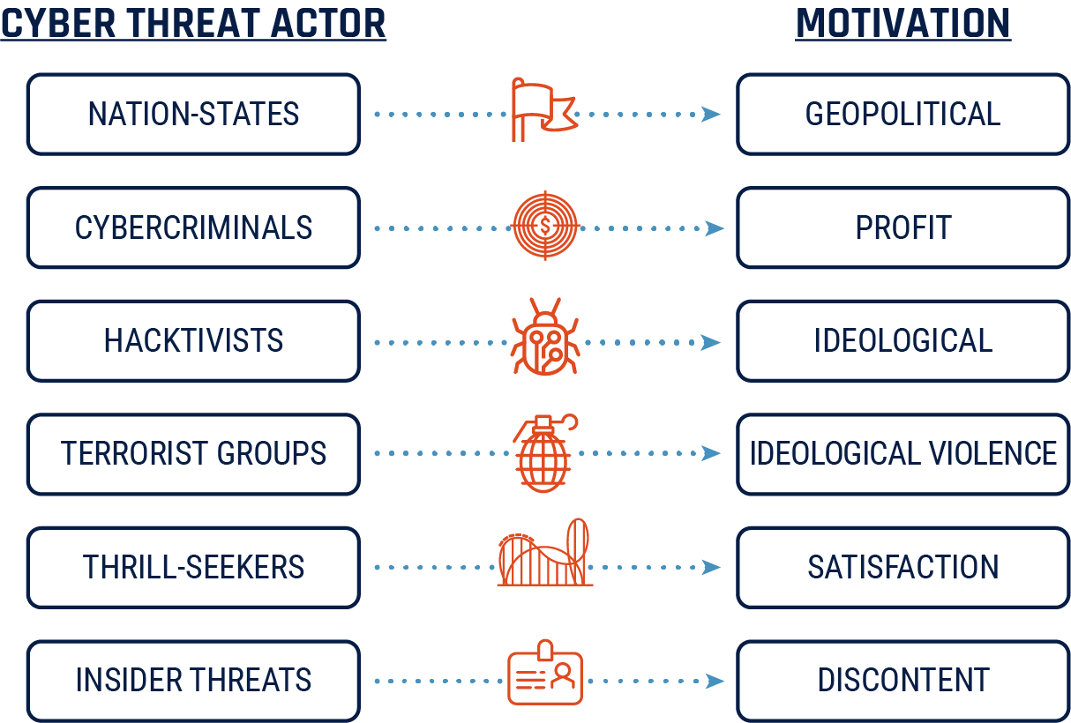
Who is conducting cyber espionage?
PRIVATE INDUSTRY
PROFIT
Notes:
Generally speaking entities who conduct espionage are those who have a deep and ongoing need for information which will give them an advantage in power contests. Typically, although not exclusively, nation-states are the actors with these motivations. However, terrorist organizations for example may fall under this same definition while not being actually in power at the nation-state level.
There are other entities in the cyber espionage ecosystem who may support APT actors but not themselves be considered APTs. For example many government use contractors to augment their staff and while organizations such as those may become part of your investigation if they weren’t hired by the government it is assumed that they would move on to other work and therefore while they may be part of an APT’s operation they are not themselves an APT actor. Similarly, there are companies who sell tools to governments for use in their operations and those companies fall into an interesting gray space where they are themselves independent targets of investigation they play a complex role in the ecosystem and, again, are not generally viewed as APTs since they themselves are not using the malware they develop to target others.
While both APTs and hacktivisits, for example, may share some characteristics in common such as deeply rooted motiviations which are politically aligned the they are distinct in that the APT actor will typically be better funded and have a higher level of sophistication in their attacks. For each of the groups listed on this screen you can think through where they diverge from APTs in either motivation, funding, or sophistication.
Obtaining access and information (aka espionage) are common objectives however it is possible for APT actors to have other objectives such as financial motivation if that goal is tied to their nation state’s interest. For example, due to sanctions restrictions DPRK has a clear need to acquire substantial funding to maintain their nation state. For this reason it is common for DPRK APTs to have a financial motivation. However, this is a less common motivation because most nation states do not like to peg their gdp to cyber crime.

Slide 35
Advanced Persistent Threat (APT) Actors
“An adversary with sophisticated levels of expertise and significant resources, allowing it through the use of multiple different attack vectors (e.g., cyber, physical, and deception) to generate opportunities to achieve its objectives, which are typically to establish and extend footholds within the information technology infrastructure of organizations for purposes of continually exfiltrating information and/or to undermine or impede critical aspects of a mission, program, or organization, or place itself in a position to do so in the future; moreover, the advanced persistent threat pursues its objectives repeatedly over an extended period of time, adapting to a defender’s efforts to resist it, and with determination to maintain the level of interaction needed to execute its objectives.”
NIST
Notes:
In the field of cyber espionage we call the actors who conduct cyber espionage advanced persistent threat actors or APTs. The core aspects of the definition of who is considered an APT is that they are sophisticated, well funded, and have deep motivation to achieve their ends.

Slide 36
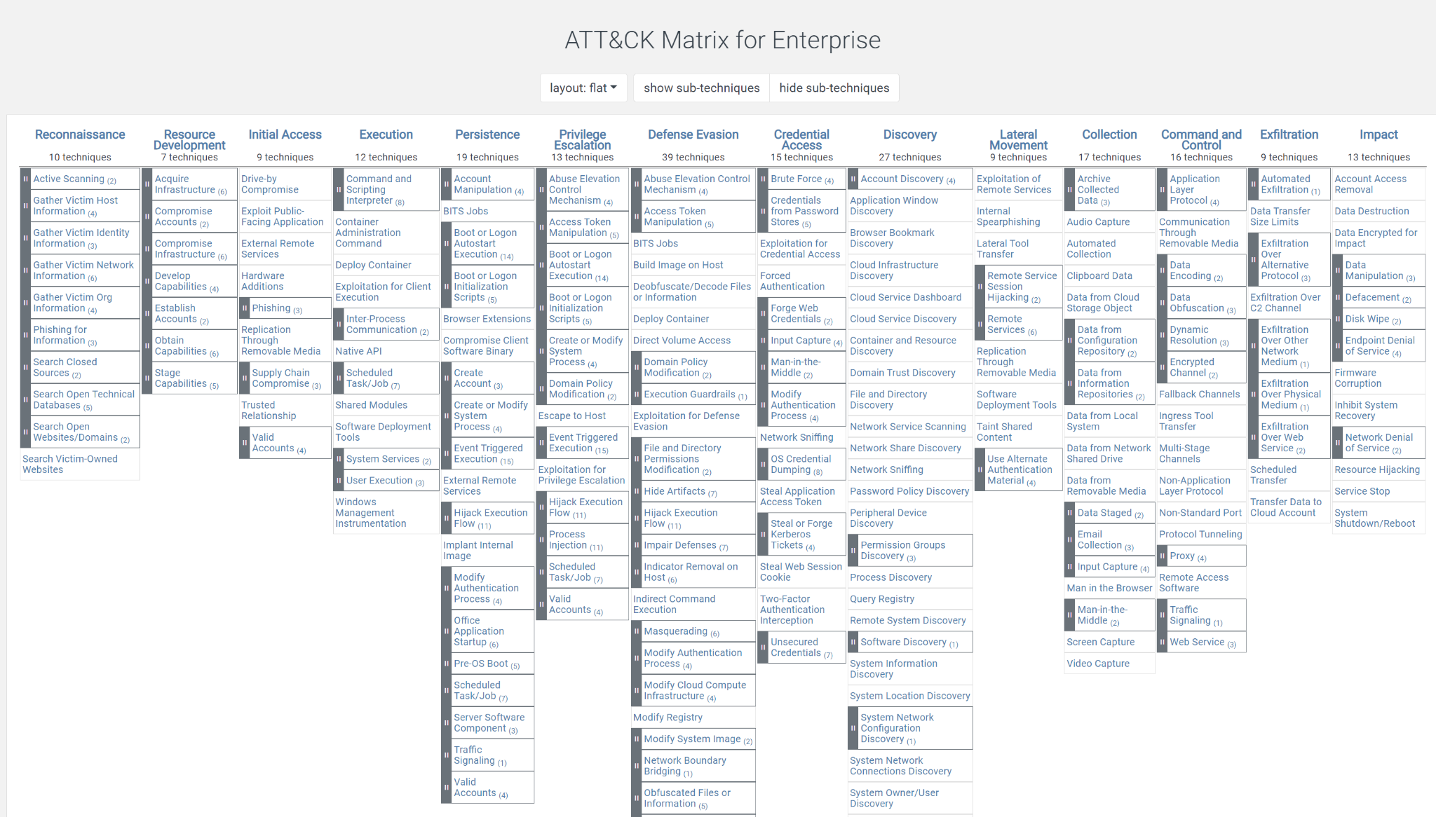
Cyber Espionage Tactics
Notes:
There are many different frameworks for understanding the steps that APT actors use to conduct an attack. Two common frameworks are the Lockheed Killchain and the Mitre Att&ck Framework. We know that you have likely covered these in other courses so we aren’t going to get too deep on these but it is worth looking through the ATT&CK Matrix at the enumerated set of tactics which can be used at each phase of an attack. At a high level some of the tactics which are common to see in cyber espionage attacks are:
Reconnaissance which can take many forms from viewing the target’s social media profiles, to engaging with them directly via chat services to get information out of them.
Account compromise is another common and important tactic
Finally, malware delivery and exploitation! This is critical. While malware can be used in the ecrime context as well it is a hallmark of cyber espionage operations.

Slide 37
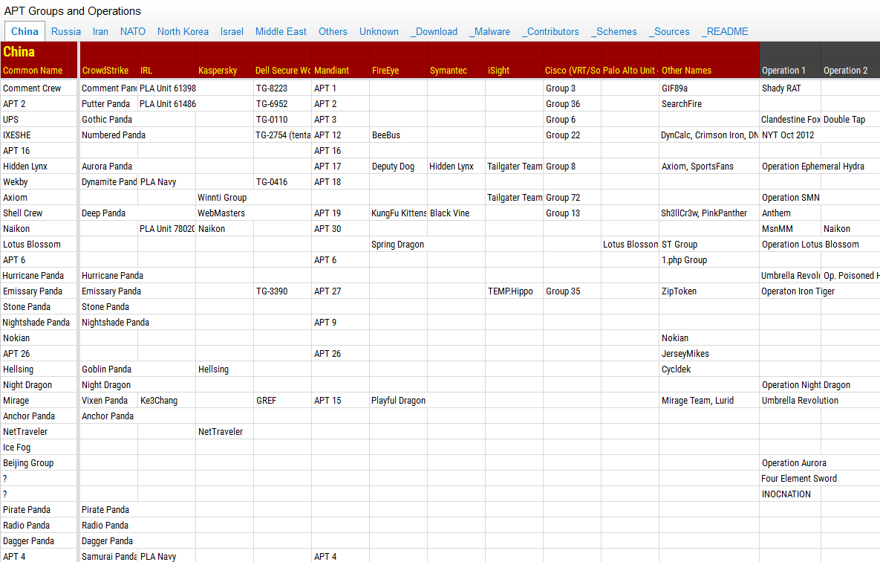
Referencing APTs
Notes:
It is important when analysts and organizations are tracking and sharing information to ensure that everyone in the industry is talking about the same things so we have to give APTs names. Each organization who tracks this activity will need some way to group and reference the activity they believe is clustered together and so it is common for each organization to give a particular activity set their own name. Many organizations use the naming convention adjective + unique country identifier. However, others will use a numbering system such as referencing the actors by APT 1 - 100.
Government agencies who track this activity give actors names, however, they are not in the business of sharing this information publicly. However, private sector cyber threat intelligence firms are literally in the business of selling this information for profit and sharing this information publicly for credibility. Therefore, the names the most successful private sector organizations use tend to have the most traction. Most notably FireEye uses the convention APT# so if you hear someone reference APT15 you know that this is meant to reference the FireEye naming of the actor. Whereas, CrowdStrike uses the convention [word] + unique country identifier so Vixen Panda.
The screenshot on this slide is what we typically call a “Rosetta Stone” aka a guide to all of the different names that different orgs use to reference the same actors.

Slide 38
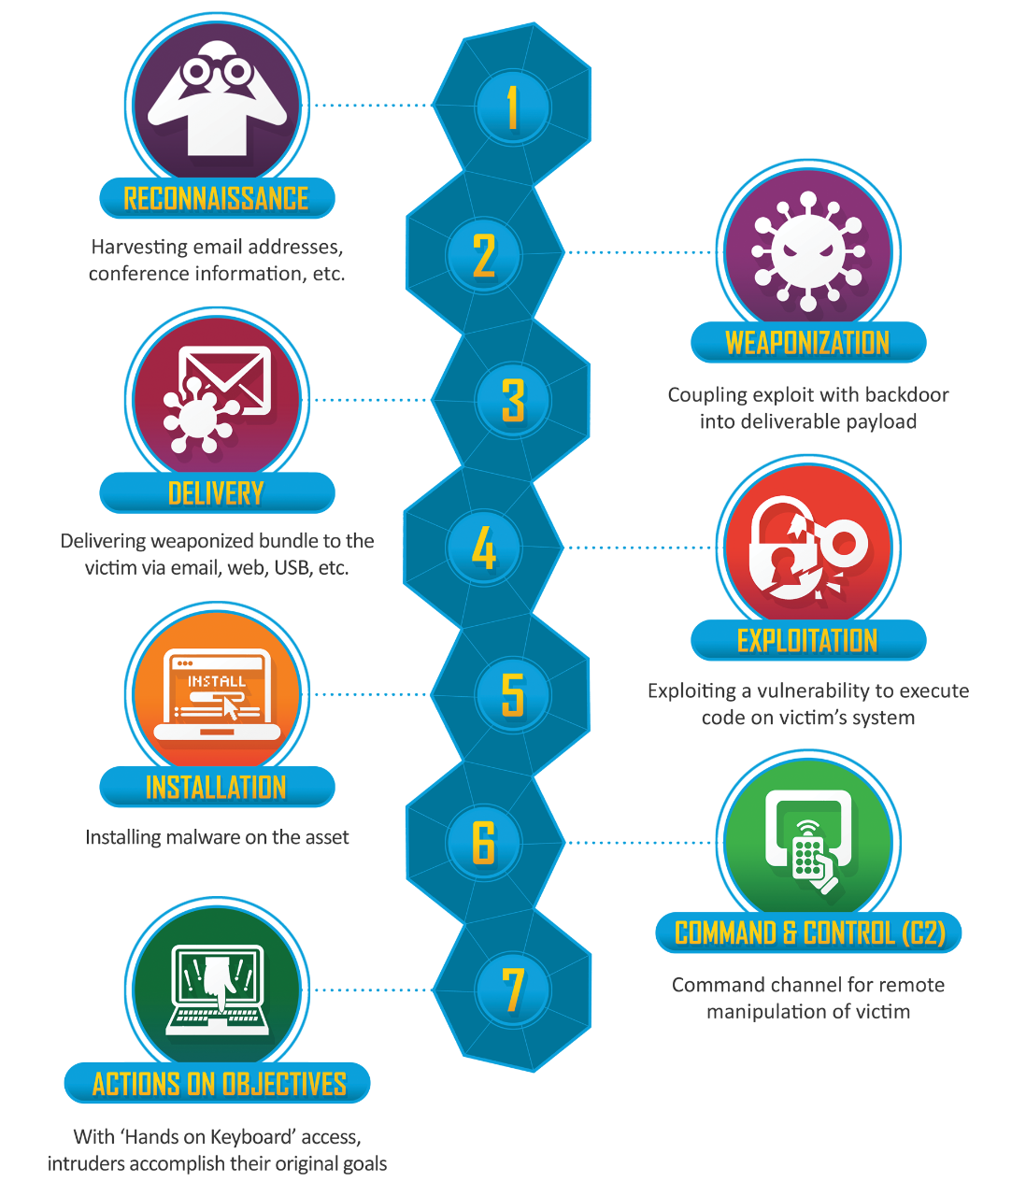
Many Names - Same APT?
Facebook, Google
Google, Microsoft, Telecomms
Anti-Virus Companies, Palo Alto Networks, FireEye
Apple, Microsoft, Anti-Virus Companies
CloudFlare, AWS
CrowdStrike, CarbonBlack, Malwarebytes, Cisco
Notes:
This image is, of course, the Lockheed Killchain.
Each organization who tracks APTs will have slightly different visibility into the activity. By that I mean that if you are a telecomm company then your purview includes interactions like phone calls and text messages. Therefore, you may have insight into which phone numbers are being used to send text-based phishing messages by APT actors and to whom they are being sent. However, if you are Google you will have insight into what searches those APT actors are conducting and what phishing emails they are sending. Finally, if you are AWS you may have information on what cloud infrastructure they are using to host their malware. Based on the data you have access to you will have a different view into the activity set and that will bias your understanding of the actor.
It is, therefore, possible that based on visibility two analysts could be tracking the same actor but have little hard technical evidence to connect the two cases. Or, the opposite, organizations could see overlap in their technical evidence and be tempted to call the cases the same activity set but could be wrong in doing so if they are missing key data which would indicate divergence.

Slide 39
Indicators of compromise (IOCs)
Indicators of compromise (aka IOCs aka indicators) are pieces of forensic data, such as data found in system log entries or files, that identify potentially malicious activity on a system or network.
IP Address
Domain / URL
Malware Hash
Email Address
Phone Number
Notes:
As threat analysts our job is to use the technical artifacts which are generated by APT actors to track the activity that they are conducting across the internet. The full definitions, such as the one on the slide, come from a forensic experience and assume that an IOC is connected to a breach or other form of malicious activity.
However, analysts use the term a bit more broadly to mean any indicators associated with a particular activity set.
There are a few indicators which are most commonly used in investigative work: IP addresses, domains, malware hashes, email addresses, phone numbers, etc.

Slide 40
Indicators of compromise (IOCs)
IP Address
Domain
URL
IPv4: 12.244.233.165
IPv6: 2001:0db8:0000:0000:0000:ff00:0042:7879
www.virustotal.com
https://www.virustotal.com/gui/home/search
Email Address
Phone Number
lbh22@georgetown.edu
610-724-8186
Malware Hash
md5: 3d95e1c94bd528909308b198f3d47620
sha256: 2b03806939d1171f063ba8d14c3b10622edb5732e4f78dc4fe3eac98b56e5d46
Notes:
As you start to work with IOCs it will be important for you to be able to recognize them and start to comfortably reference them in your work.

Slide 41
OSI & TCP/IP Models
Type of Tech
Layer
Protocols
Application
Websites / apps
HTTP
IMAP
FTP
Transport
Ports
TCP
UDP
Network
Packets
IP
Data Link
Switches
Ethernet
Physical
Cables
USB
Notes:
There are two ways to approach understanding IOCs. At the most basic you need to know how to recognize them and at least know the definition for what they are so for example you need to know what an IPv6 looks like and need to have some familiarity with the concept that an IP address represents a specific connection out to the internet.
The deeper approach is to start understanding how technology interconnects. For myself, I have found that it is not until I have learned how each technology came about and why they interconnect that I have been able to have facility with discussing and using each in investigations. In this section I am going to go into some of that explanation; however, there is too much to fit into one session. So we are going to introduce some fundamentals and then we will come back to this lecture and complete it later in the course once we have more experience interacting with these types of data.
As you are familiar with already models such as the kill chain and ATT&CK frameworks there are many conceptual models in computing and cybersecurity which help us to visualize and understand how technology works. One such model is the Open Systems Interconnection model which is more commonly referred to as the OSI model. The OSI model is used to represent how computing systems communicate. The TCP/IP model is a simplified version of the OSI model and that’s what you see on this slide.
TCP / IP was originally developed by the DOD. It illustrates the different layers of technology and processes which exist between the physical computer at the lowest level and a software application at the highest level.
On the slide I have broken this down into the model layer (physical, data link, network, transport, and application) and then mapped those to the type of technology which you can think of being key at that layer (cables, switches, packets, ports, and websites) and finally mapped those to the protocols which enable each layer to work.
Each of these protocols has an accompanying RFC, introduced a couple of slides ago, and you can go read the paper which explains how that protocol works to connect that layer to the layer above and below it.
Over the next few slides we are going to walk through a few of these layers to give you more detail on how they work.
----
Notes for students to read but not to say during class:
Each of these layers is characterized by specific protocols which govern other interactions.
The application layer are comprised of protocols such as HTTP for web browsing, SMTP and IMAP define how email delivery works, and FTP defines how file transfer works.
The transport layer establishes some protocols which dictate which ports will listen for which types of data.
The network layer is one which we are all very familiar with and which we are going to dive into deeply day which is IP.
The data link and physical layers move data from device to device.
Memorizing this model isn’t important for investigative work but it is important to understand each of the components because those are the IOCs we were just learning about!

Slide 42
Physical Layer
Type of Tech
Layer
Protocols
Application
Websites / apps
HTTP
IMAP
FTP
Transport
Ports
TCP
UDP
Network
Packets
IP
Data Link
Switches
Ethernet
Physical
Cables
USB

Slide 43
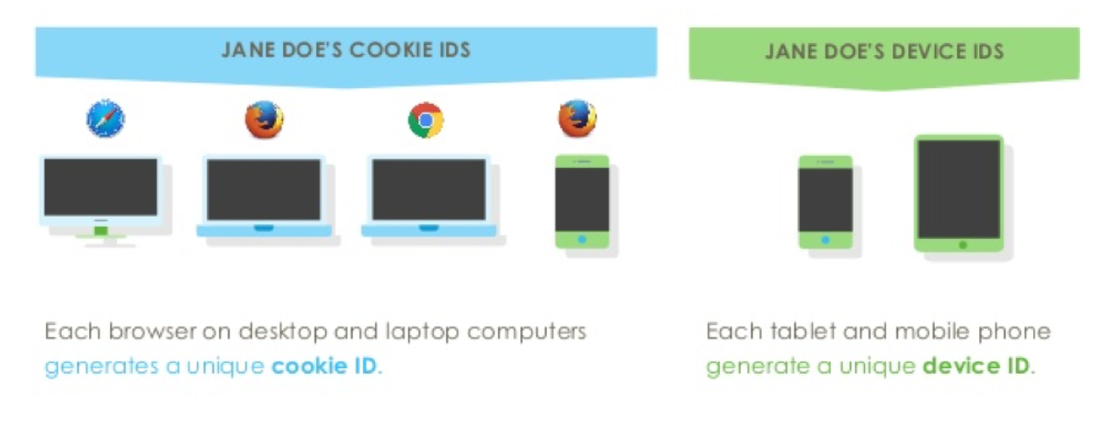
Device Identifiers
Notes:
Every device has a unique identifier. A Device ID is a string of numbers and letters that identifies every individual smartphone or tablet in the world. It is stored on the mobile device and can be retrieved by any app that is downloaded and installed. Apps typically retrieve the ID for identification when talking to server.
We are unlikely to interact with a lot of device IDs in this course because publicly available datasets do not generally have access to the specific devices which have been impacted by a particular attack. However, in a work environment you will commonly have this info and it is critical info to inform your understanding of the scope of impact.

Slide 44
Data Link Layer
Type of Tech
Layer
Protocols
Application
Websites / apps
HTTP
IMAP
FTP
Transport
Ports
TCP
UDP
Network
Packets
IP
Data Link
Switches
Ethernet
Physical
Cables
USB
Notes:
Moving up from the device to the data link layer...

Slide 45
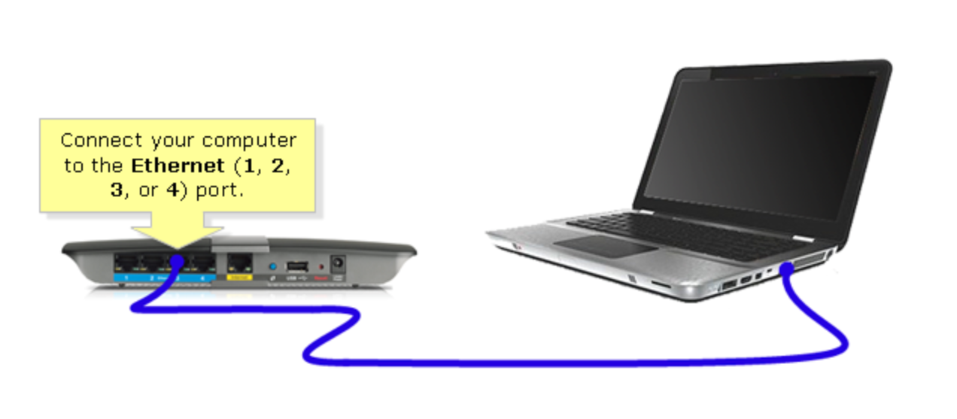
Walking up the model
Notes:
In here we have routers and switches. You can trace things like how many routers a given web request went through before reaching the destination. These are called hops. From an investigative perspective it can be important and interesting to see how a particular request is routed around the internet because, for example, we would expect that if I initiate a request from the White House to go to Google we would not expect it to route through, let’s say, Russian IP space. I’ve included some notes on the slides which walk you through how to run what’s called a trace route to see the connections your own computer makes to get you to the domain you are interested in.
---
For the curious you can see how many hops it takes for your request to go to a particular website from your computer and IP address. You will need to open the terminal (aka command line) on your computer. Then run what is called a trace route. Just type in tracert [space] [domain] and click [enter]. For example:
tracert www.google.com
You will then see the exact connections your request makes to get you to google.com. You will be able to glean some interesting info from this. For example, I can see that my internet service provider (ISP) brings my request through 4 hops they own before it gets outside of their network. It is also interesting to see that from my home to google is 13 hops but from my house to facebook is 8.
You can then try your hand at researching the IP addresses (more detail on that in a few slides) to see what countries they are in. It would be pretty odd, for example, if I were to makea request from my home in DC for my request to route through, let’s say, a Russian IP address.

Slide 46
Network Layer
Type of Tech
Layer
Protocols
Application
Websites / apps
HTTP
IMAP
FTP
Transport
Ports
TCP
UDP
Network
Packets
IP
Data Link
Switches
Ethernet
Physical
Cables
USB
Notes:
The network layer is where we get to IP addresses!

Slide 47
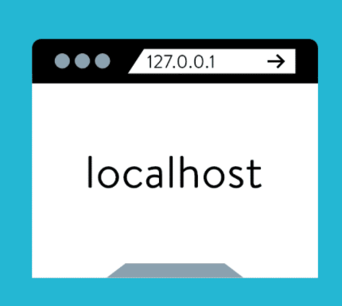
IPs! Yay!
Notes:
Said in the most boring way possible, an IP address is a numerical label assigned to each device connected to a computer network that uses the Internet Protocol for communication. Said more simply an IP address is another unique identifier which identifies each device’s unique connection to the internet or to an intranet.
While most IP addresses connect us out to the internet there are special IPs which as a security person you must be able to recognize. One of the most important ones to recognize off the jump is 127.0.0.1. This is an IP address which doesn’t go out to the internet but rather enables a device to access the network services specific to that device. The device is called localhost aka the device in your hand. Each device has its own local network running of services specific to that phone.
But we are getting a bit ahead of ourselves as we need to explain in more detail what is going on with IP addresses.

Slide 48
IP Addresses - IPv4
207.172.135.17
Lowest Possible IP Address
Highest Possible IP Address
0.0.0.0
255.255.255.255
Notes:
IPv4 addresses are always four numbers separated by periods.
For the curious - Each number is an octet meaning that each can be represented by a byte which is 8 bits...an octet. The highest decimal number which can be represented in one byte is 255. This means that the lowest possible IP address is 0.0.0.0 and the highest possible IP address is 255.255.255.255. If you see 464.172.999.88 you know that is not real.
The range of possible IP addresses is called “IP space.”

Slide 49
CIDR
172.16.1.0 /24
“Slash 24”
Notes:
We aren’t going to dive into CIDR notation but know that if you see something like an IP address with a slash and a number that’s something called CIDR notation and it is an additional way to allocate IP space. You may hear someone verbally call an IP address by its CIDR range saying something like “It’s a slash 24.”

Slide 50
IPv6
2001:0db8:85a3:0000:0000:8a2e:0370:7334
Numbers
Letters
Colons
So long!
Notes:
IPv4 addresses likely looked familiar to you because they have been along longer and have been more commonly in use on the internet. However, the issue is that when Ipv4 was created there were between 4 and 5 billion allocatable addresses. When they created IPv4 they thought that would be sufficient for the world. But the explosion of devices in the world meant that ultimately we ran out. This is why they moved on to IPv6.
There are more IPv6 addresses available because they are longer.
It is pretty easy to tell them apart because IPv4 as we saw was comprised only of numbers whereas IPv6 can contain both letters and numbers.
For the curious - That’s because IPv6 addresses don’t use decimal numbers they use hexadecimal numbers. Hex numbers can be between 0-9 and between a-f. You have most likely interacted with Hex if you have ever chosen an RGB color, those are often referenced by their exact hex encoding.

Slide 51
IPv6
2001:0db8:85a3:0000:0000:8a2e:0370:7334
2001:0db8:85a3::8a2e:0370:7334
2001:db8:85a3::8a2e:370:7334
Notes:
Alright so to state the obvious. IPv6 addresses are long and who wants to type all of that? No one. So there are some ways to shorten them. First, you can replace the first two hextets of all 0s with a double colon ::. But note that you can only replace the first one. After that what you can do is to replace all leading 0s by just dropping them. We won’t go into more detail here but just know that there are ways to shorten IPv6 addresses down and you should know that you are still looking at an IPv6 address.

Slide 52
Transport Layer
Type of Tech
Layer
Protocols
Application
Websites / apps
HTTP
IMAP
FTP
Transport
Ports
TCP
UDP
Network
Packets
IP
Data Link
Switches
Ethernet
Physical
Cables
USB

Slide 53
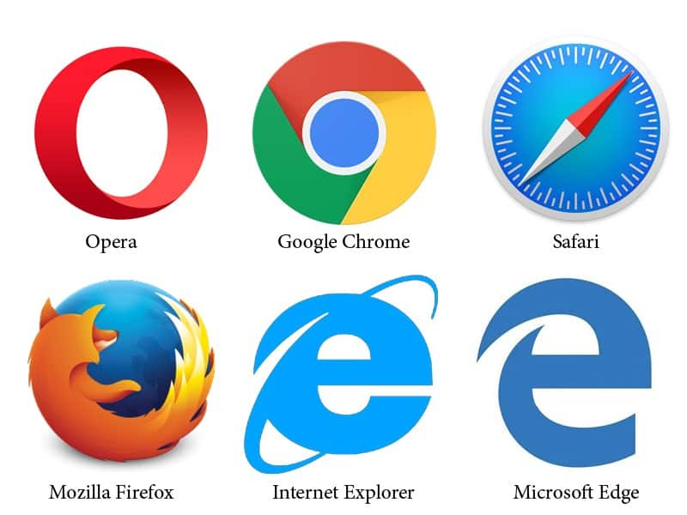

Client-Server Architecture
Notes:
Connections between computers are generally facilitated with a client-server architecture. What this means is that there are programs called servers that are running on computers that await connections from other programs, called clients. The client makes requests of the server, and the server sends responses.
When you fetch a webpage, for example, your computer’s web browser acts as your client. It sends a web request to a a program hosting the webpage - the server - which serves you the site as a response to your request. The web browser then renders the data that the server provided to it for you to view.
While we commonly think of this architecture with web requests, it actually happens in many other contexts as well.

Slide 54
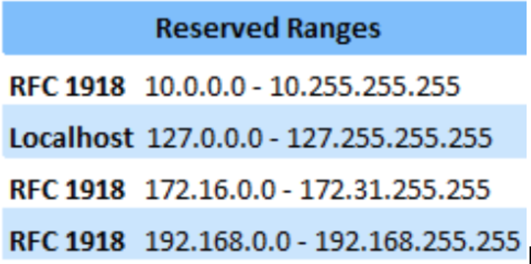
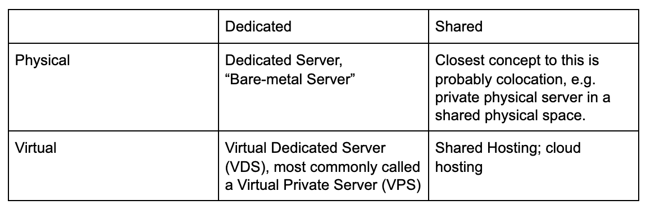
Common Types of Hosting
Infra to know & common “gotchas”:
Proxies:
Open, Reverse
VPS
VPN
TOR
Dynamic DNS
Reserved Ranges
Parking Spaces
Sinkholes
Load Balancers, Virtual IP & NAT
Notes:
Hosting is an important component of investigative work and we are going to come back to this later in the course.
Explain how they are used by attackers and in an investigative sense.

Slide 55
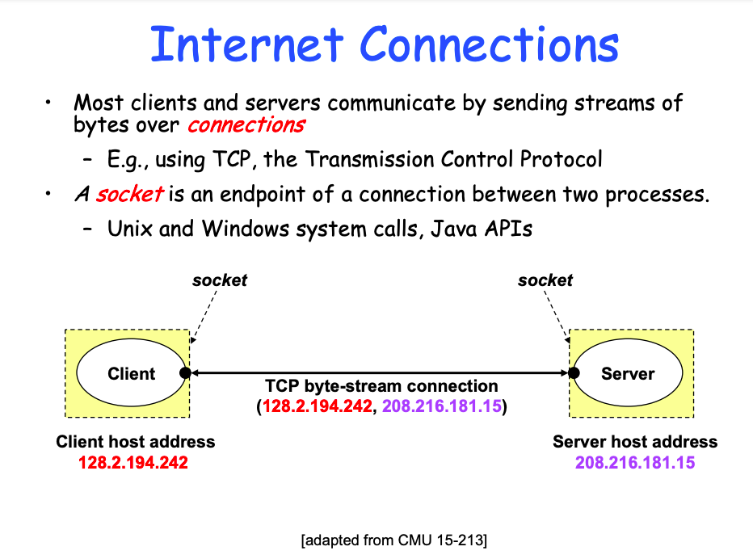
Sockets
Notes:
In any client-server architecture, web based or not, the endpoints of a connection between two processes are called sockets. The diagram on this slide, shamelessly stolen from a duke presentation that also shameless stole it from a CMU presentation (https://users.cs.duke.edu/~chase/cps196/slides/sockets.pdf), we see an example TCP request with a client and a server.
Our client, which is the computer on the left, is one of our endpoints for this TCP connection. The computer on the right is hosting our server. The software that handles the communication between these two endpoints are our sockets.
In order for the two programs to talk to one another, there has to be an established protocol for how this is accomplished. Each program has an IP address that is used to identify it uniquely on the network.

Slide 56
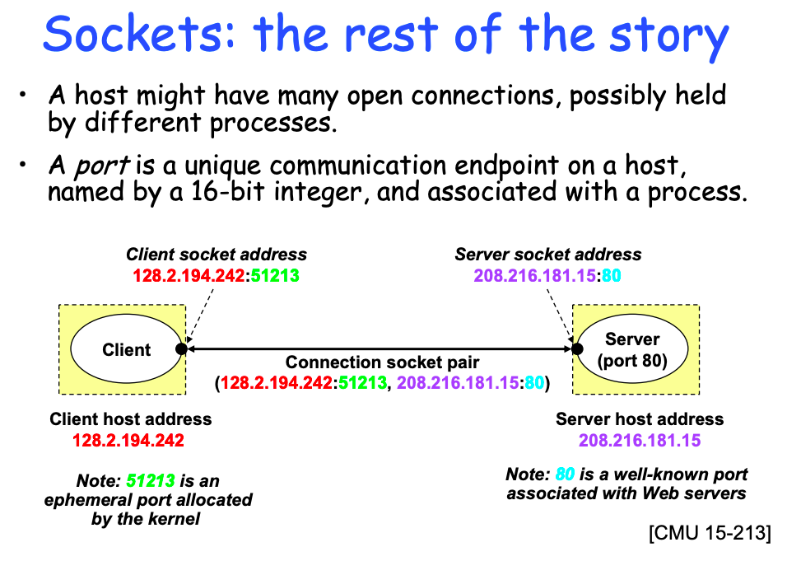
Ports
Notes:
In addition to its own address, each program needs a way to identify and talk to the right program on the other machine. This is done through ports. Ports are unique communication endpoints on each host. These unique endpoints are numbered (using 16-bit integers).
Each unique endpoint can be associated with a process. Some of these are determined ad-hoc by programs, and others have specific ports that are typically assigned for their specific process - some common examples you might be familiar with are things like http requests that usually come over port 80 whereas an https connection is made on port 443.
The server waits and listens to the socket for a client to make a connection request on its assigned port. If a connection is successfully made, the server will then open up different port so that it can continue to listen to the original socket for connection requests while supporting the new client.

Slide 57
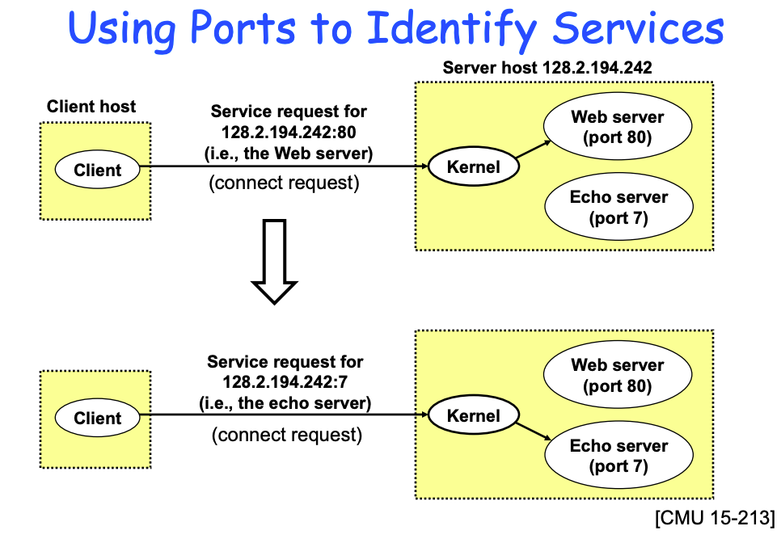
Why we care:
Notes:
So this is a ton of low-level networking stuff in a Python course - why do we care?
Well, we care about this architecture for a ton of reasons in security. For example certain ports are affiliated with certain common services. If you know the common ports, you can determine what services a server offers and guess at how the server is used. We often use this in investigations to determine what an attacker is doing.
Attackers will operate servers on the internet for various malicious purposes, such as hosting a phishing page, hosting malware, sending and receiving malicious instructions and data, and so on. When we find a server that we think belongs to an attacker, if we can figure out what ports it responds on, we can start to put together a picture of what that server is used for!

Slide 58
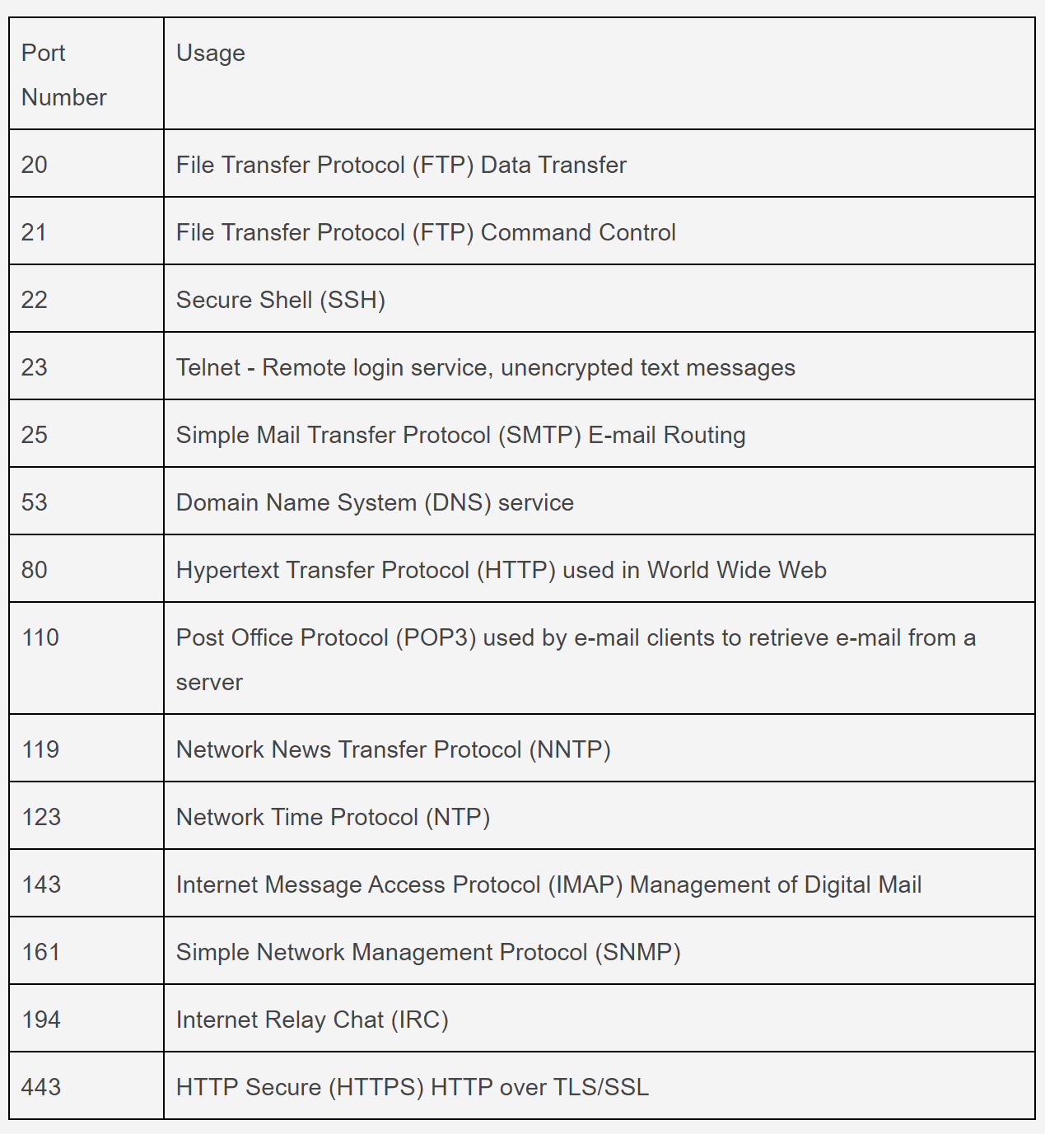
Ports!
Notes:
A computer port is a type of electronic, software- or programming-related docking point through which information flows from a program on your computer or to your computer from the Internet or another computer in a network.
In computer terms, a computer or a program connects to somewhere or something else on the Internet via a port.
Ports are numbered for consistency and interoperability across devices. The most commonly used and best known ports are those numbered 0 to 1023 dedicated for Internet use, but they can extend far higher for specialized purposes. Each port set or range is assigned specialized jobs or functions, and that's generally all they do. Usually, all identical system services or functions use the same port numbers on the receiving servers.
The ports highlighted on the slide are some of the most common ports in use. The cannoncial port to know is port 80 which is used for HTTP traffic aka web traffic.
From a security perspective it is important to know that you can open and close ports. Meaning that you can say either a port is or is not accepting that type of communication. If a particular protocol is deemed to be insecure and you don’t want your computer to ever accept that sort of traffic then you need to close those ports. For example, FTP isn’t secure so many businesses close ports 20 and 21 on all of their enterprise devices so that no one can exfiltrate data from the environment.

Slide 59
Application Layer
Type of Tech
Layer
Protocols
Application
Websites / apps
HTTP
IMAP
FTP
Transport
Ports
TCP
UDP
Network
Packets
IP
Data Link
Switches
Ethernet
Physical
Cables
USB

Slide 60
Domains and URLs
Notes:
So, we talked about programs talking to one another over a series of ports as a means of communicating and transferring data. When we talk about web requests, specifically, this is exactly what is happening - your browser acts as the client and needs to request a resource from a given server. Now here’s the deal: you, as the human being using that browser, need to be able to tell the program where it is you want to go. And humans are not very good at remembering long series of digits. So, instead, we have a whole process by which we resolve human-readable addresses (domains) to their current numeric IP addresses.

Slide 61
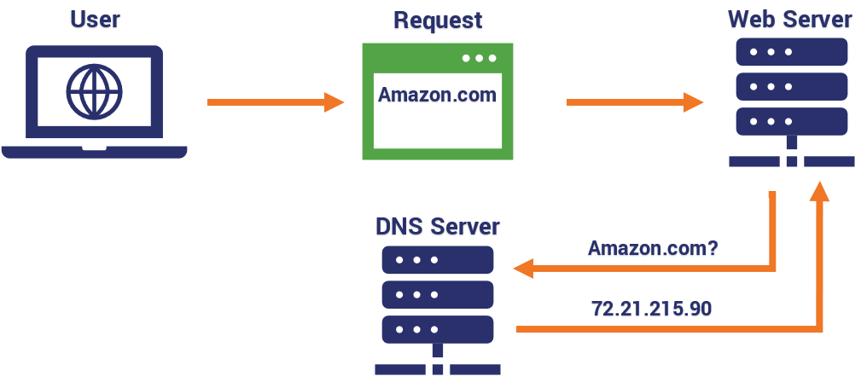
DNS
Notes:
The Domain Name System (DNS) is the phonebook of the Internet. Humans access information online through domain names, like georgetown.edu or virustotal.com. As explained web browsers interact through Internet Protocol (IP) addresses. DNS translates domain names to IP addresses.

Slide 62
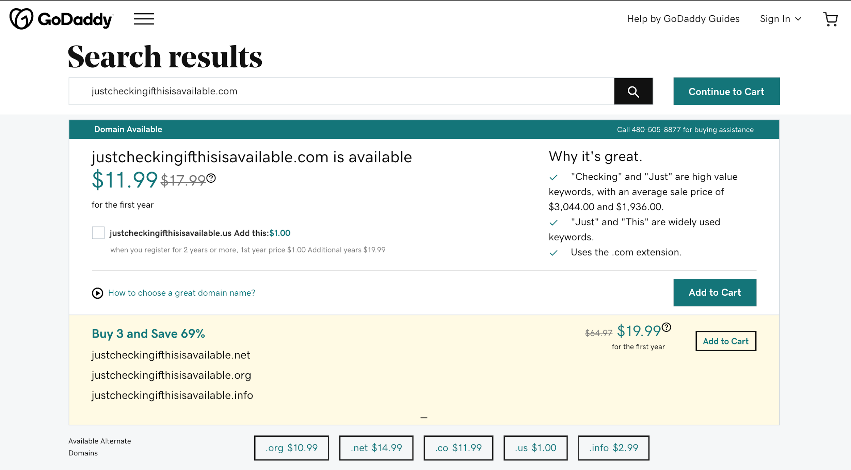
Domain Registration
Notes:
Anyone can buy a domain name. To do so, you visit a domain name registrar, such as A2, GoDaddy, or Namecheap, key in the domain you want to buy, and typically pay a fee. A domain name registrar is a business that handles the reservation of domain names as well as the assignment of IP addresses for those domain names.
The suffix identifies the site as belonging to a specific top-level domain (TLD). There are numerous TLDs available for general purchase, for example .com, .edu, .net, and .org. The most popular of these by far is .com, which is supposed to indicate commercial sites, but in reality has come to include almost everything.
An important thing to understand is that there can be many domains assigned to the same IP address. From an investigative perspective let’s say evil[.]com is registered using GoDaddy and GoDaddy assigns this to the same IP address as a local business named noelssandwichshop[.]com if you were to decide that everything coming from that IP address is bad then you would incorrectly be assuming that the sandwich shop is bad.
----
For the curious I put the period in evil[.]com in brackets because I am doing what is called defanging the domain. Defanging means modifying the information so that the reader cannot accidentally interact with the content and get hurt. Here for example if you click on evil[.]com it will not bring you to the site. This is an important practice to ingrain so that you do not accidentally interact with malicious content or cause others to do so.

Slide 63
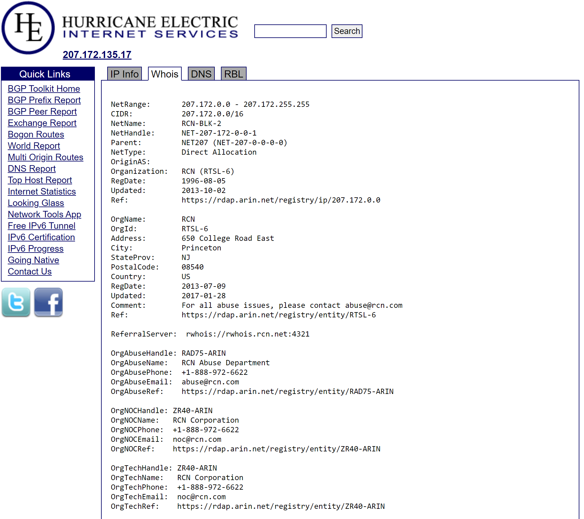
WHOIS Records
Notes:
Every year, millions of individuals, businesses, organizations and governments register domain names and use IP addresses. Each one must provide identifying and contact information which may include: name, address, email, phone number, and administrative and technical contacts. This information is often referred to as "WHOIS data." But the WHOIS service is not a single, centrally-operated database. Instead, the data is managed by independent entities known as "registrars" and "registries.
You can lookup the WHOIS record for a given IP address or domain. In the screenshot on the slide we used the Hurricane Electric BGP tool to pull back the WHOIS record for a particular IP address. You will see that the WHOIS contains a lot of the info we just talked about and also shows the org name that is responsible for this IP (in this case RCN an internet service provider).
However, domain name registrars have set up various “cloaking” services in which a WHOIS lookup on a domain will simply return the contact information of the registrar itself and not of the user who actually purchased/manages the domain name.
So WHOIS records have varying utility to your investigation depending on what type of investigation you are leading. If you are investigating a sophisticated nation state APT they are extremely unlikely to have a domain registered to their HQ address with the name and phone number of their intel analyst listed. However, if you were, let’s say, a child safety investigator trying to understand where some child exploitative imagery was coming from you would be much more likely to find that the person sharing that horrible content may not have been savvy enough to cloak their info.
---
For the curious definitely play with whois lookups and try to figure out what you can learn about your favorite websites. Try some big ones (e.g. google and facebook) but also try some local businesses and see the differences you can observe. You will likely see that your local small business lists a real person’s name, address, and phone number. Whereas, facebook will hardly have Zuck’s home address and cell number listed. Try whois.com

Slide 64
To be continued
Type of Tech
Layer
Protocols
Application
Websites / apps
HTTP
IMAP
FTP
Transport
Ports
TCP
UDP
Network
Packets
IP
Data Link
Switches
Ethernet
Physical
Cables
USB
Notes:
We made it from the physical layer all the way up to the application layer and hopefully we all now have a better sense of how we get from typing in a domain name at the physical layer all the way up to accessing that website at the application layer traversing across DNS, IP addresses, ports, and routers. There are more technologies to discuss at each layer and we will come back to this TCP / IP model later in class when we need to reengage with understanding infrastructure so that we can start doing our own investigations.

Slide 65
Concepts to review from this session
Data Types (integer, floating point number)
Zen of Python
Use of Whitespace
Mathematical Operators
Casting and Conversion
Advanced Persistent Threat Actors
Indicators of Compromise (various types)

Slide 66
Q&A
Reminders:
Join office hours
Homework should be in your email already
Quiz next week, review document in email
Recommend reading in email

